Slide 1



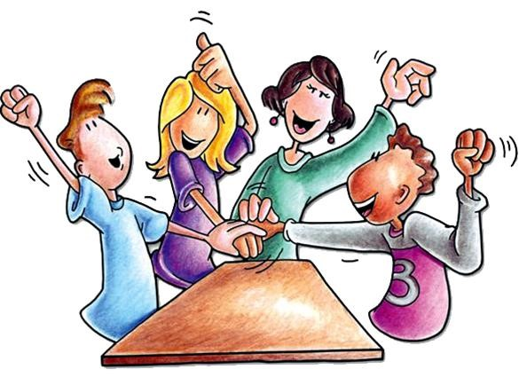

Collaborative learning
Teaching & learning at St. James’
Mr Bradley,
Curriculum Lead
Teaching & learning lead

Slide 2
Aims for the session
At St James' we use a collaborative teaching approach enabling our children to be active and accountable in lessons. Our teachers facilitate learning rather than always providing instructional direction for our children. Through the use of Kagan Structures, Magenta Principles and Oracy (Voice21), children are encouraged to lead their learning with teachers crafting outcomes with key questions, allowing dialogue, discussions and collaboration.
T&L at St. James’ – a brief journey and context
How our approach enhances learning for all – Magenta and Kagan at St. James’
Facilitation of learning or instructional learning
Collaborative learning structures

Slide 3

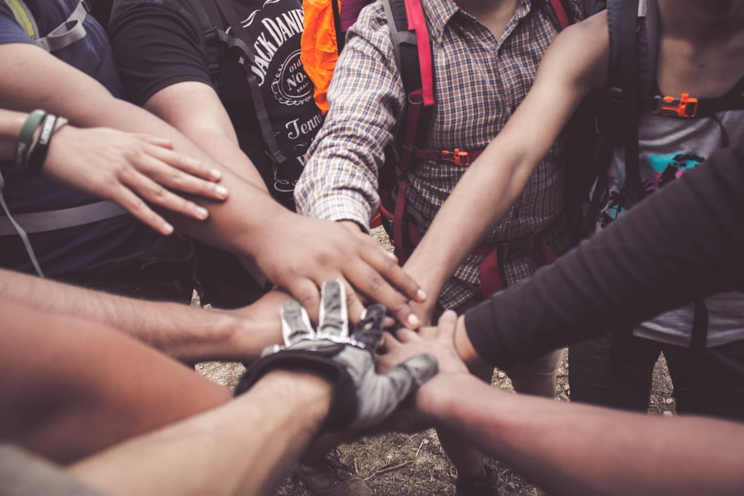

Collaboration in action
Power of working in collaboration
Generate ideas
Engagement
Jot thoughts
Notes:
Activity working on your own then working in collaboration
How many …. Can you name? individually then together
Jot thought paper??

Slide 4
Our t&l journey at St. james’ - snapshot
Over a number of years …
Magenta Principles – What are we asking our children to do with the information we give them?
Kagan CPD – collaborative learning
Active learners
Teachers – facilitation of learning rather than instructional
Coaching between colleagues
Quality conversations – Oracy with Voice21

Slide 5
Magenta principles
The Magenta Principles is an umbrella phrase that refers to a philosophy and an approach to teaching based firmly upon the premise that learning should be both exciting and engaging. More specifically, the phrase represents a pedagogy undermined by an unshakeable belief that:
Learning is the consequence of thinking
Language is central to thinking
Learning is an active process

Slide 6

Magenta principles

Slide 7
Making links

Slide 8
What do we want from the information?
All children can access in some way
No ceiling is placed on learning
Elicitation of overall understanding
Guides learning for the next stage

Slide 9

Make learning memorable

Slide 10
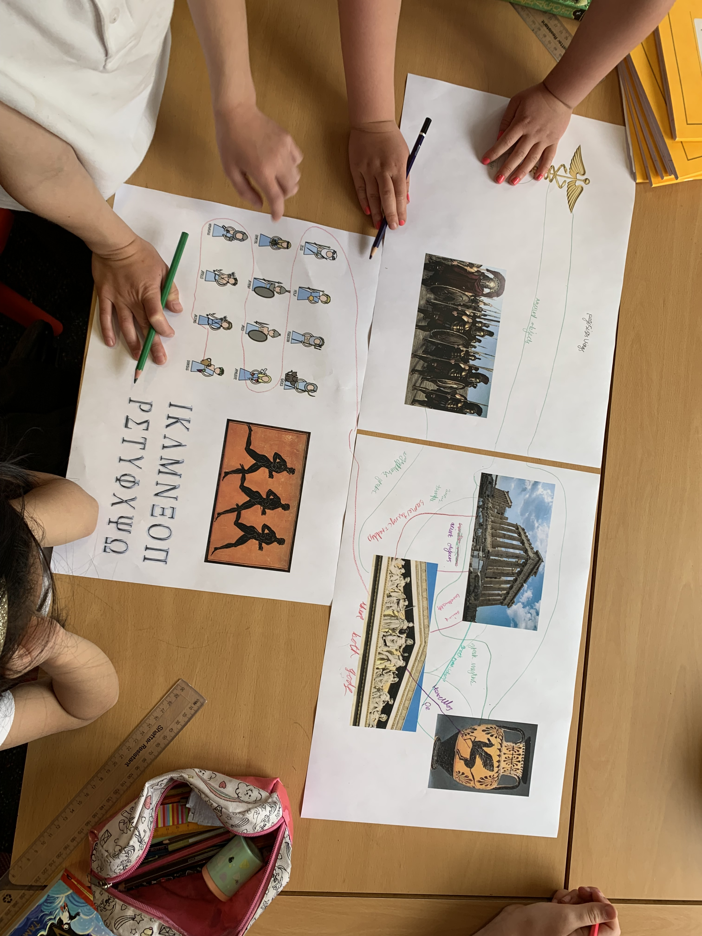
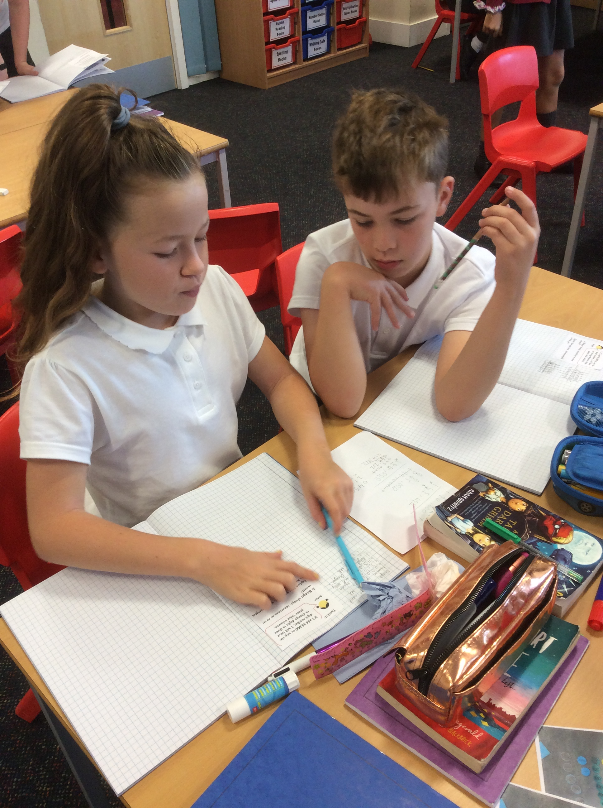
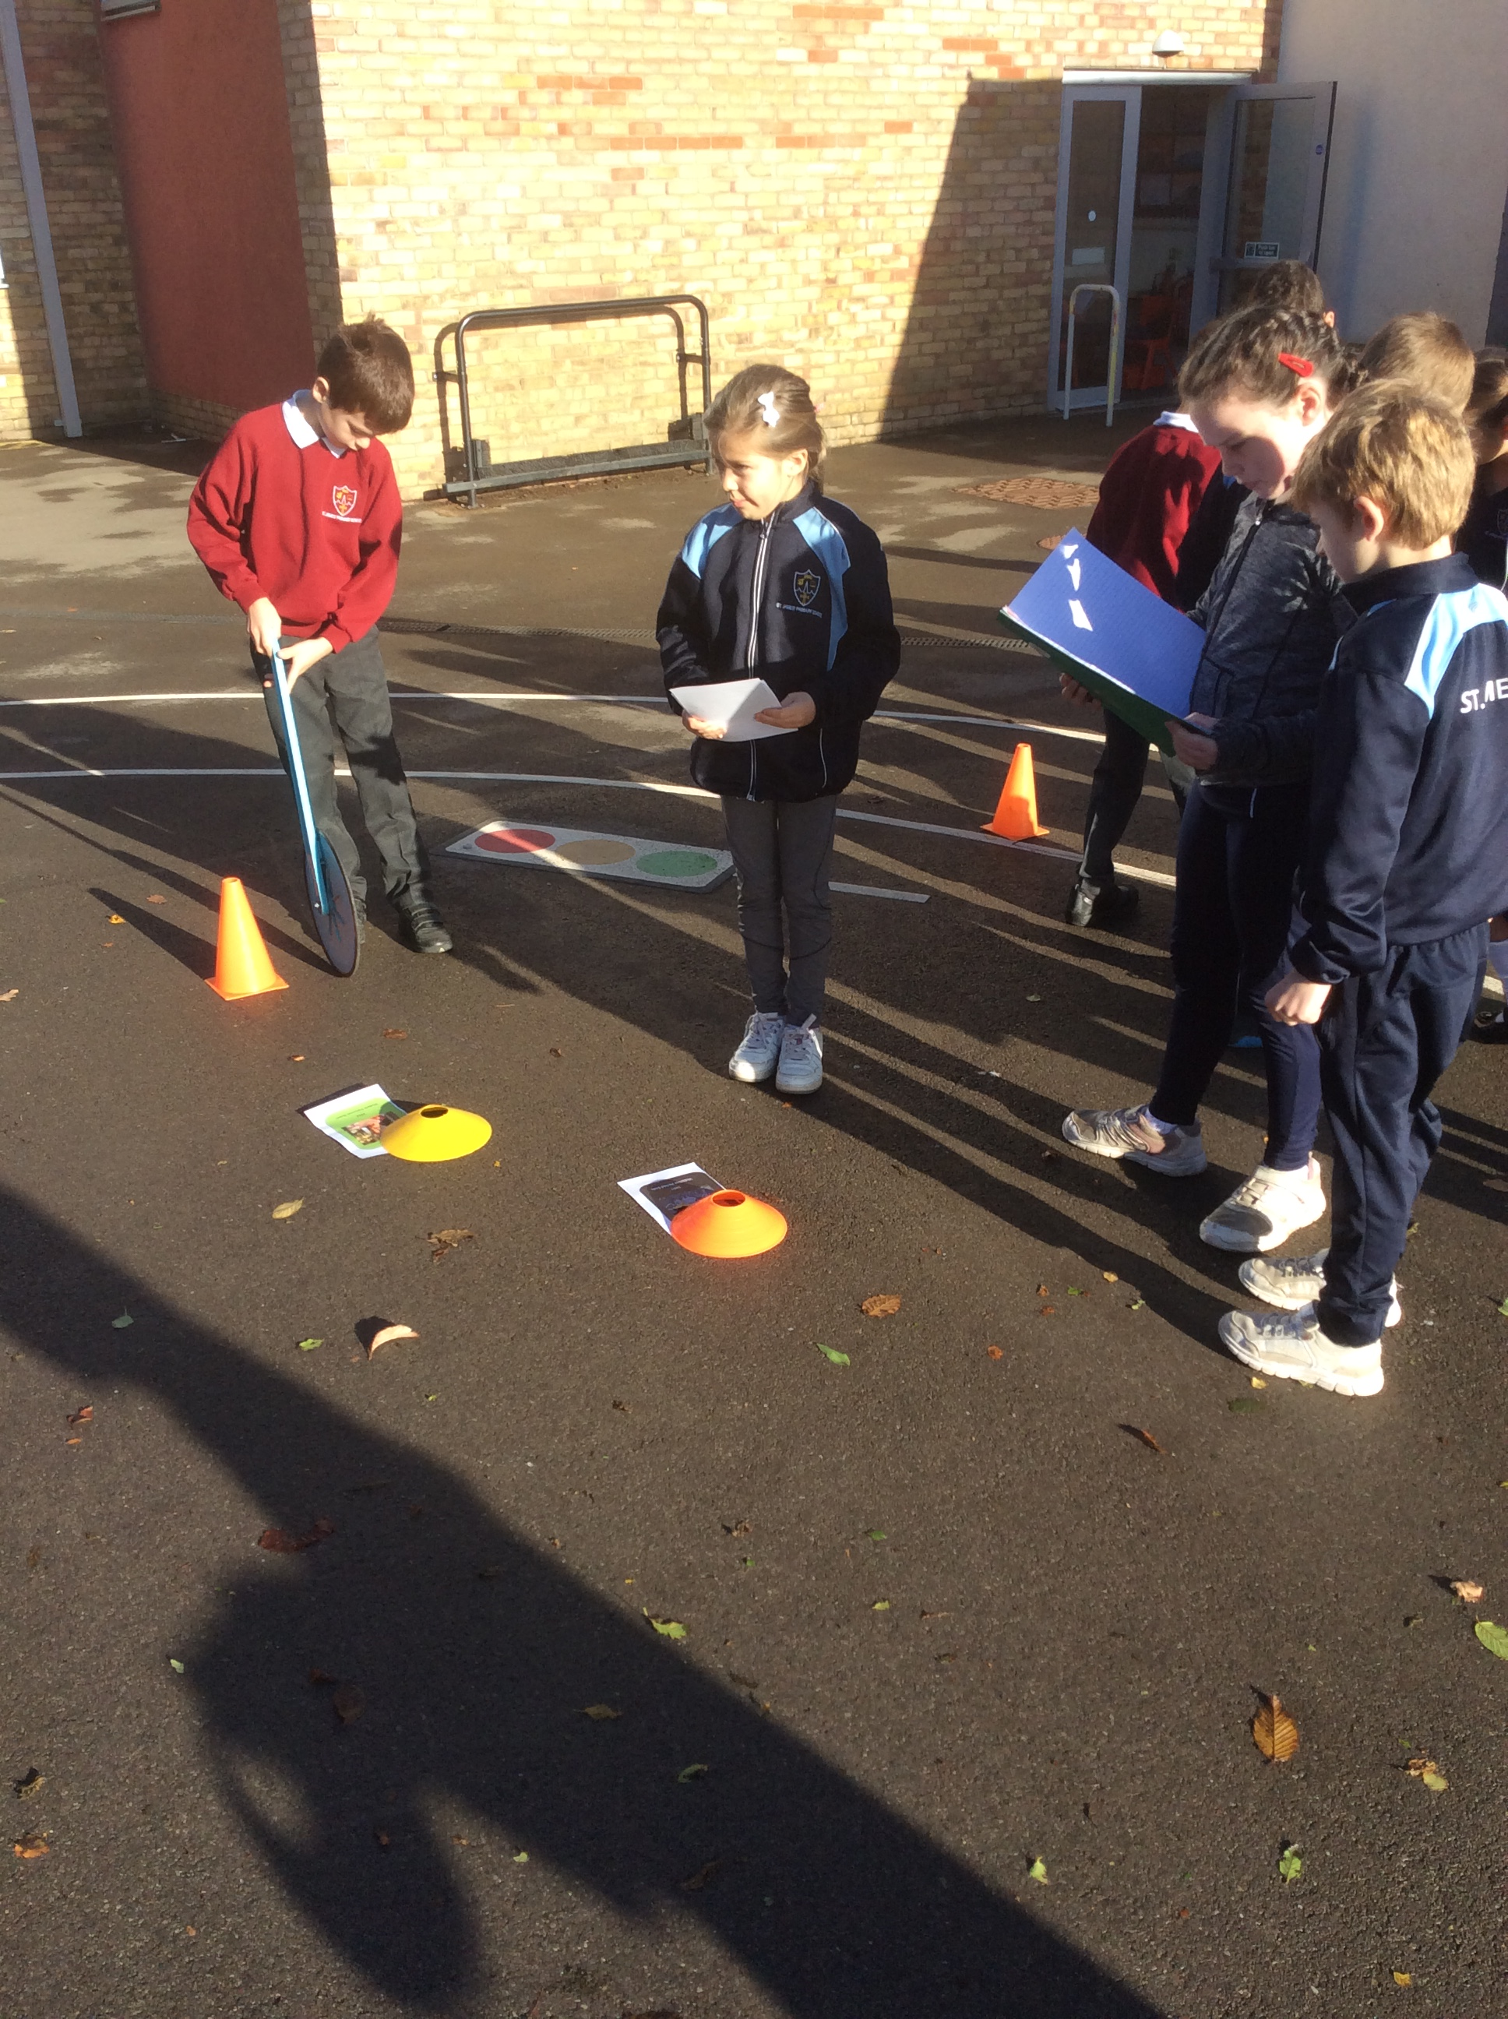
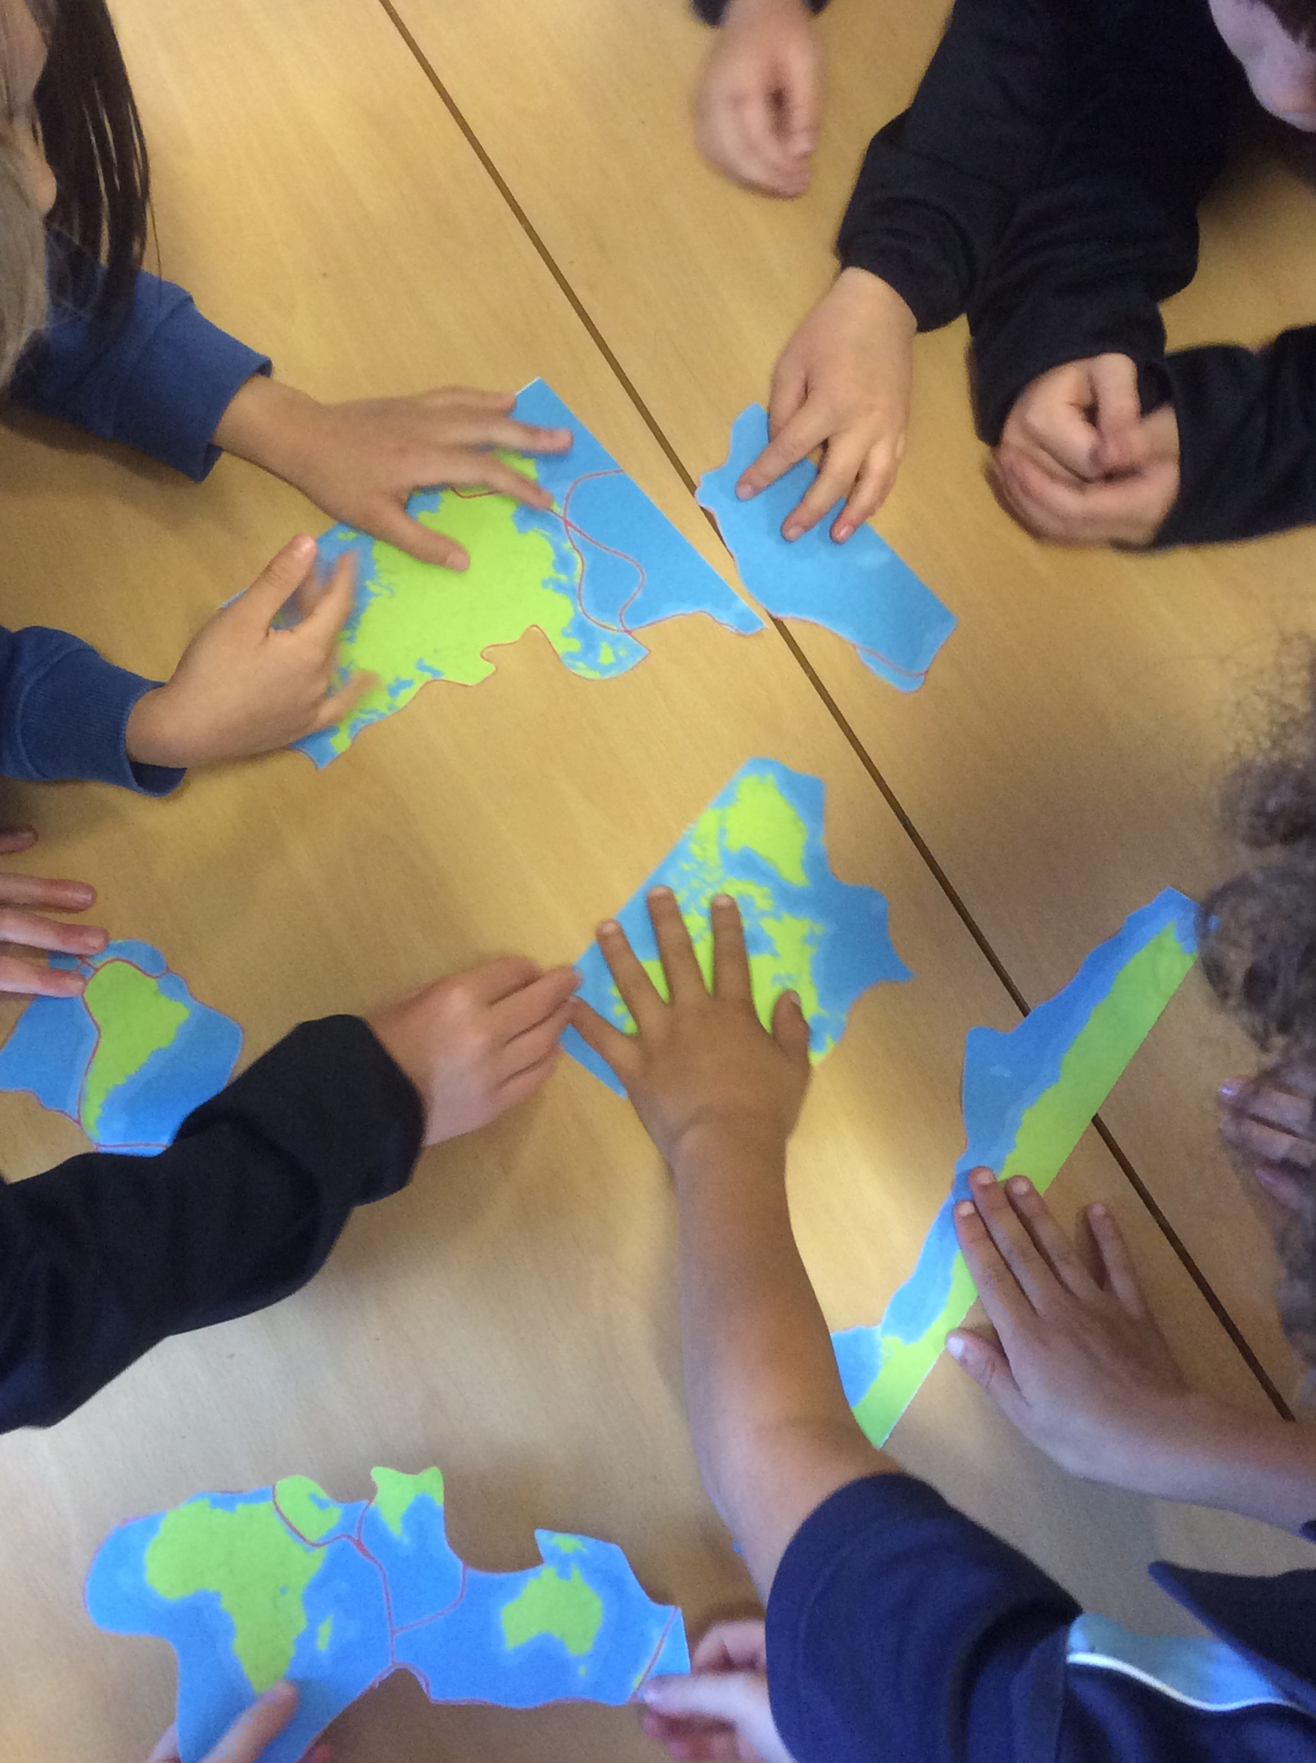
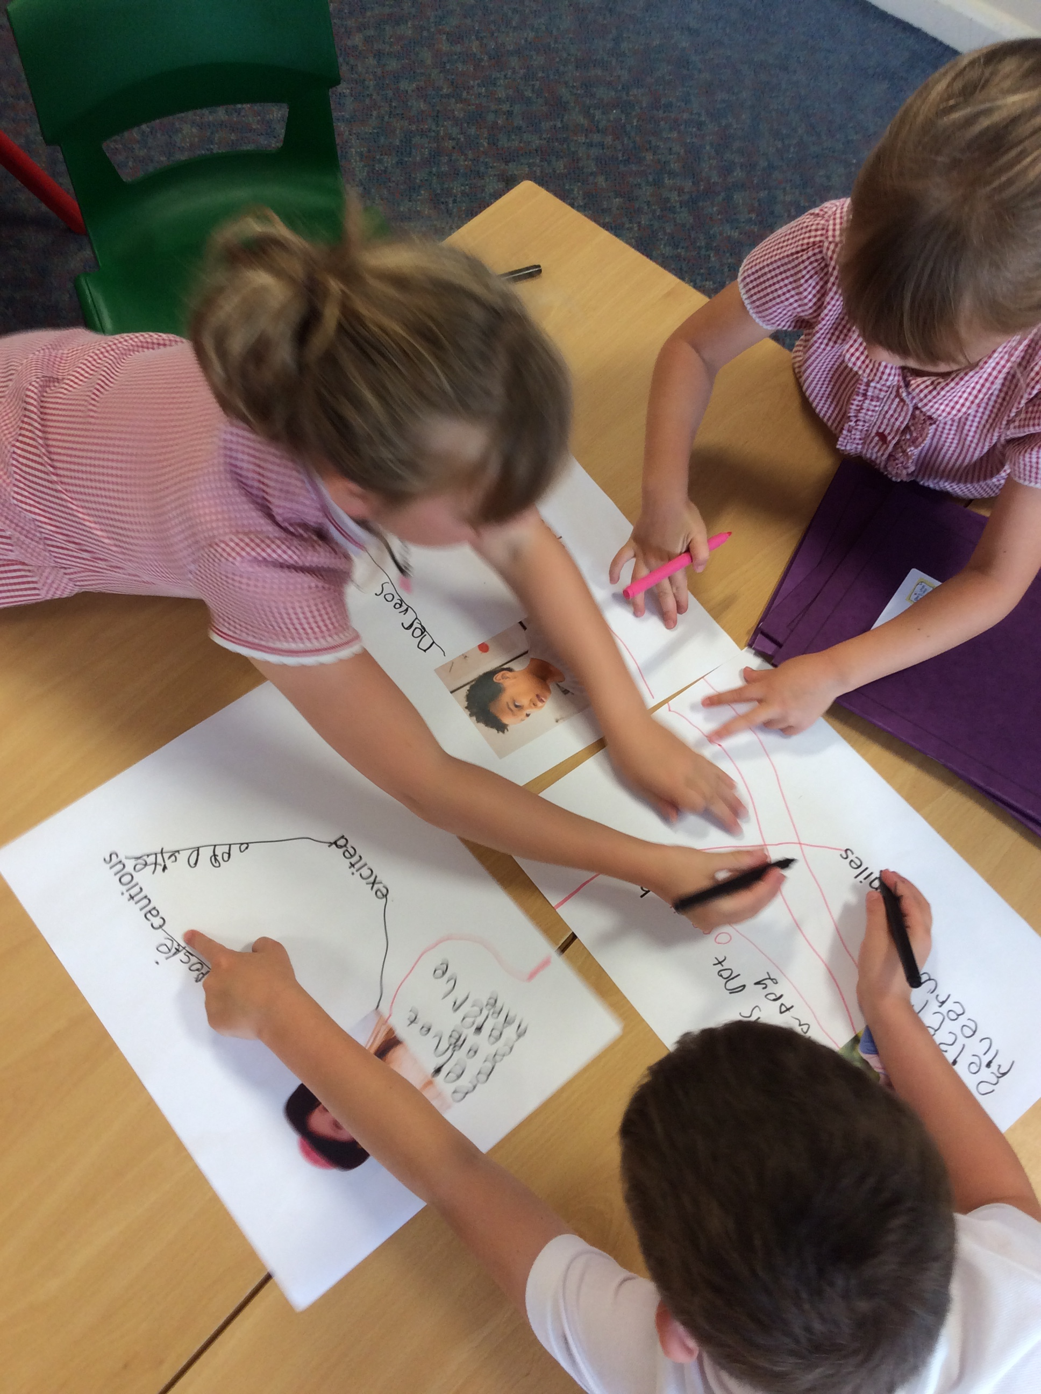
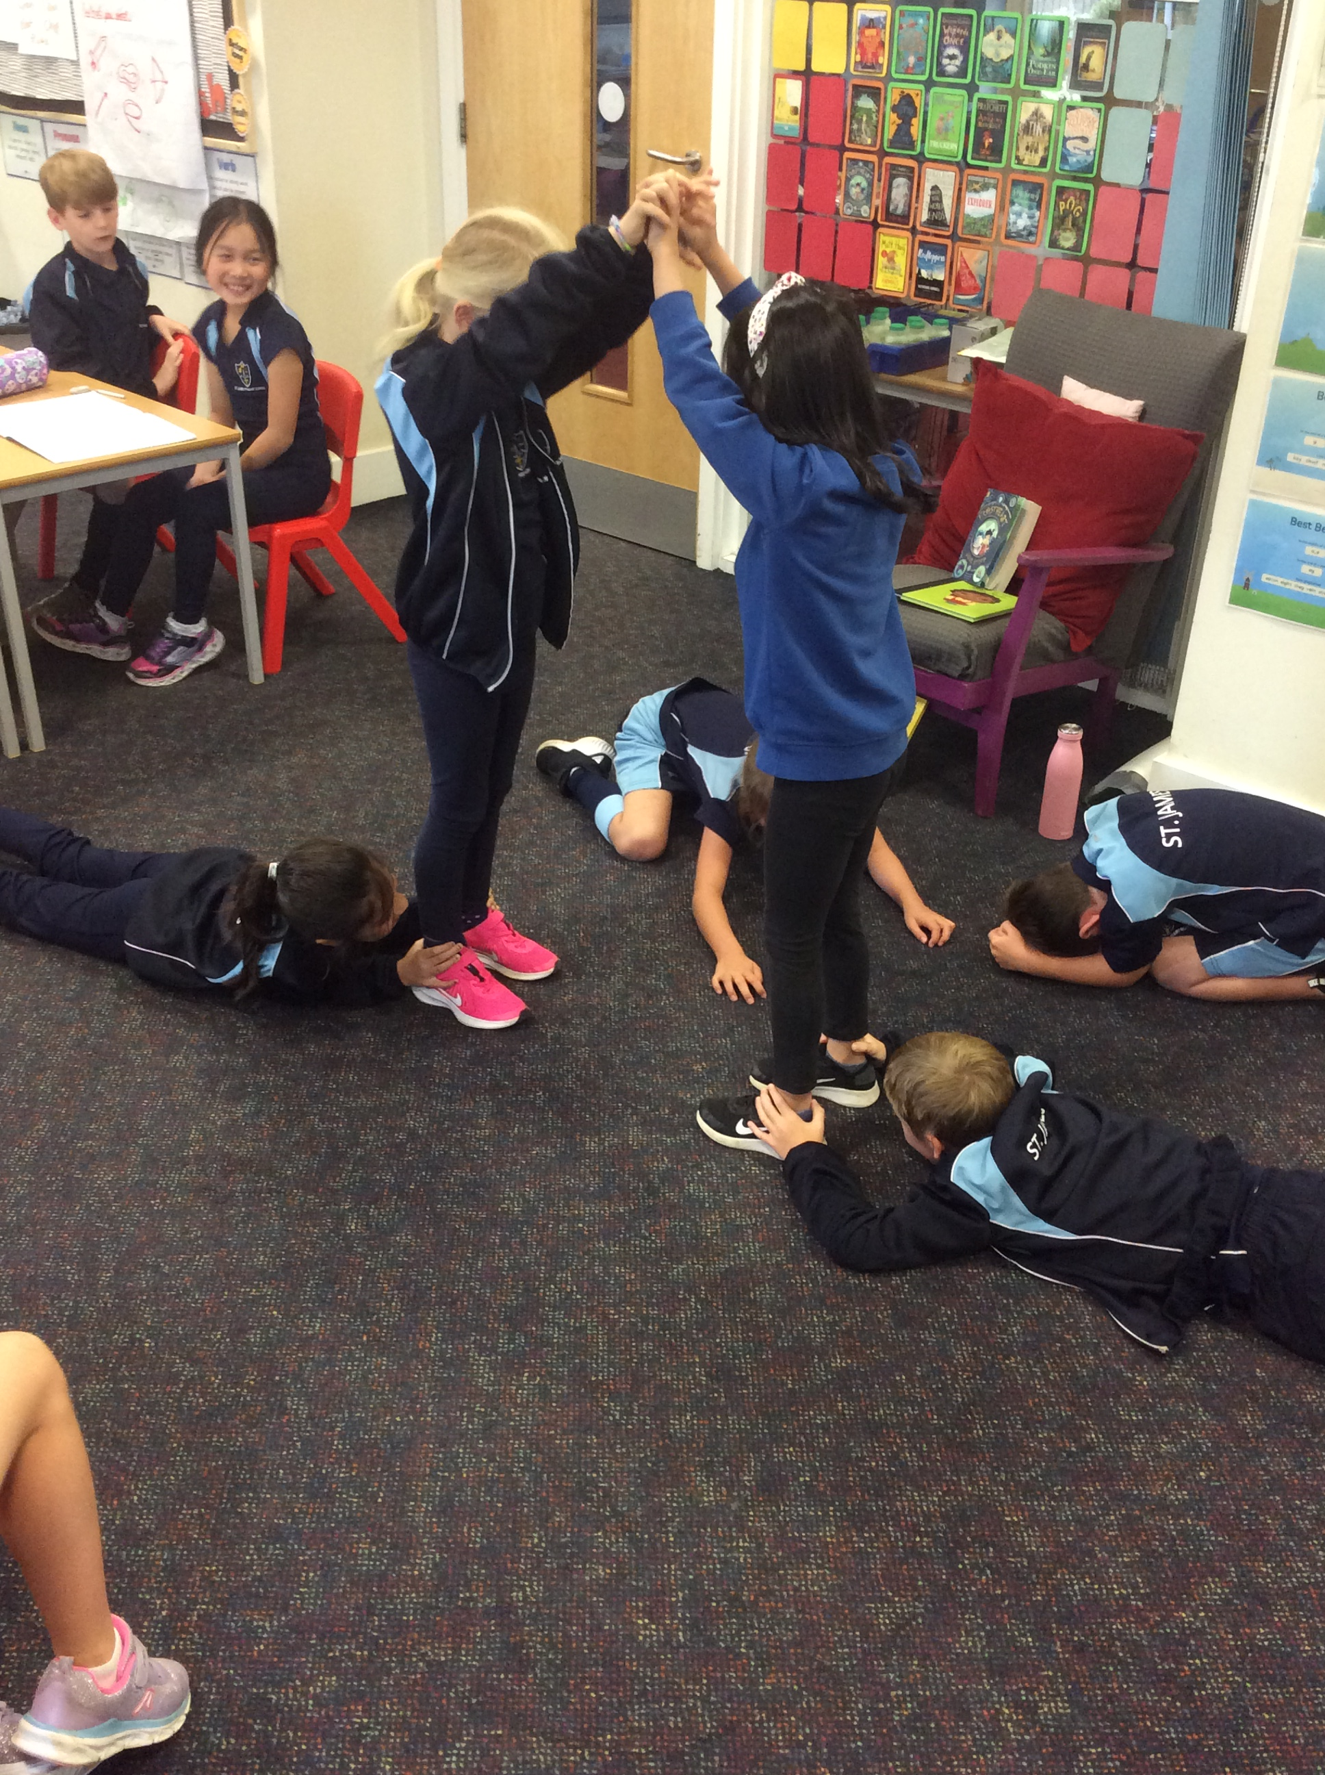
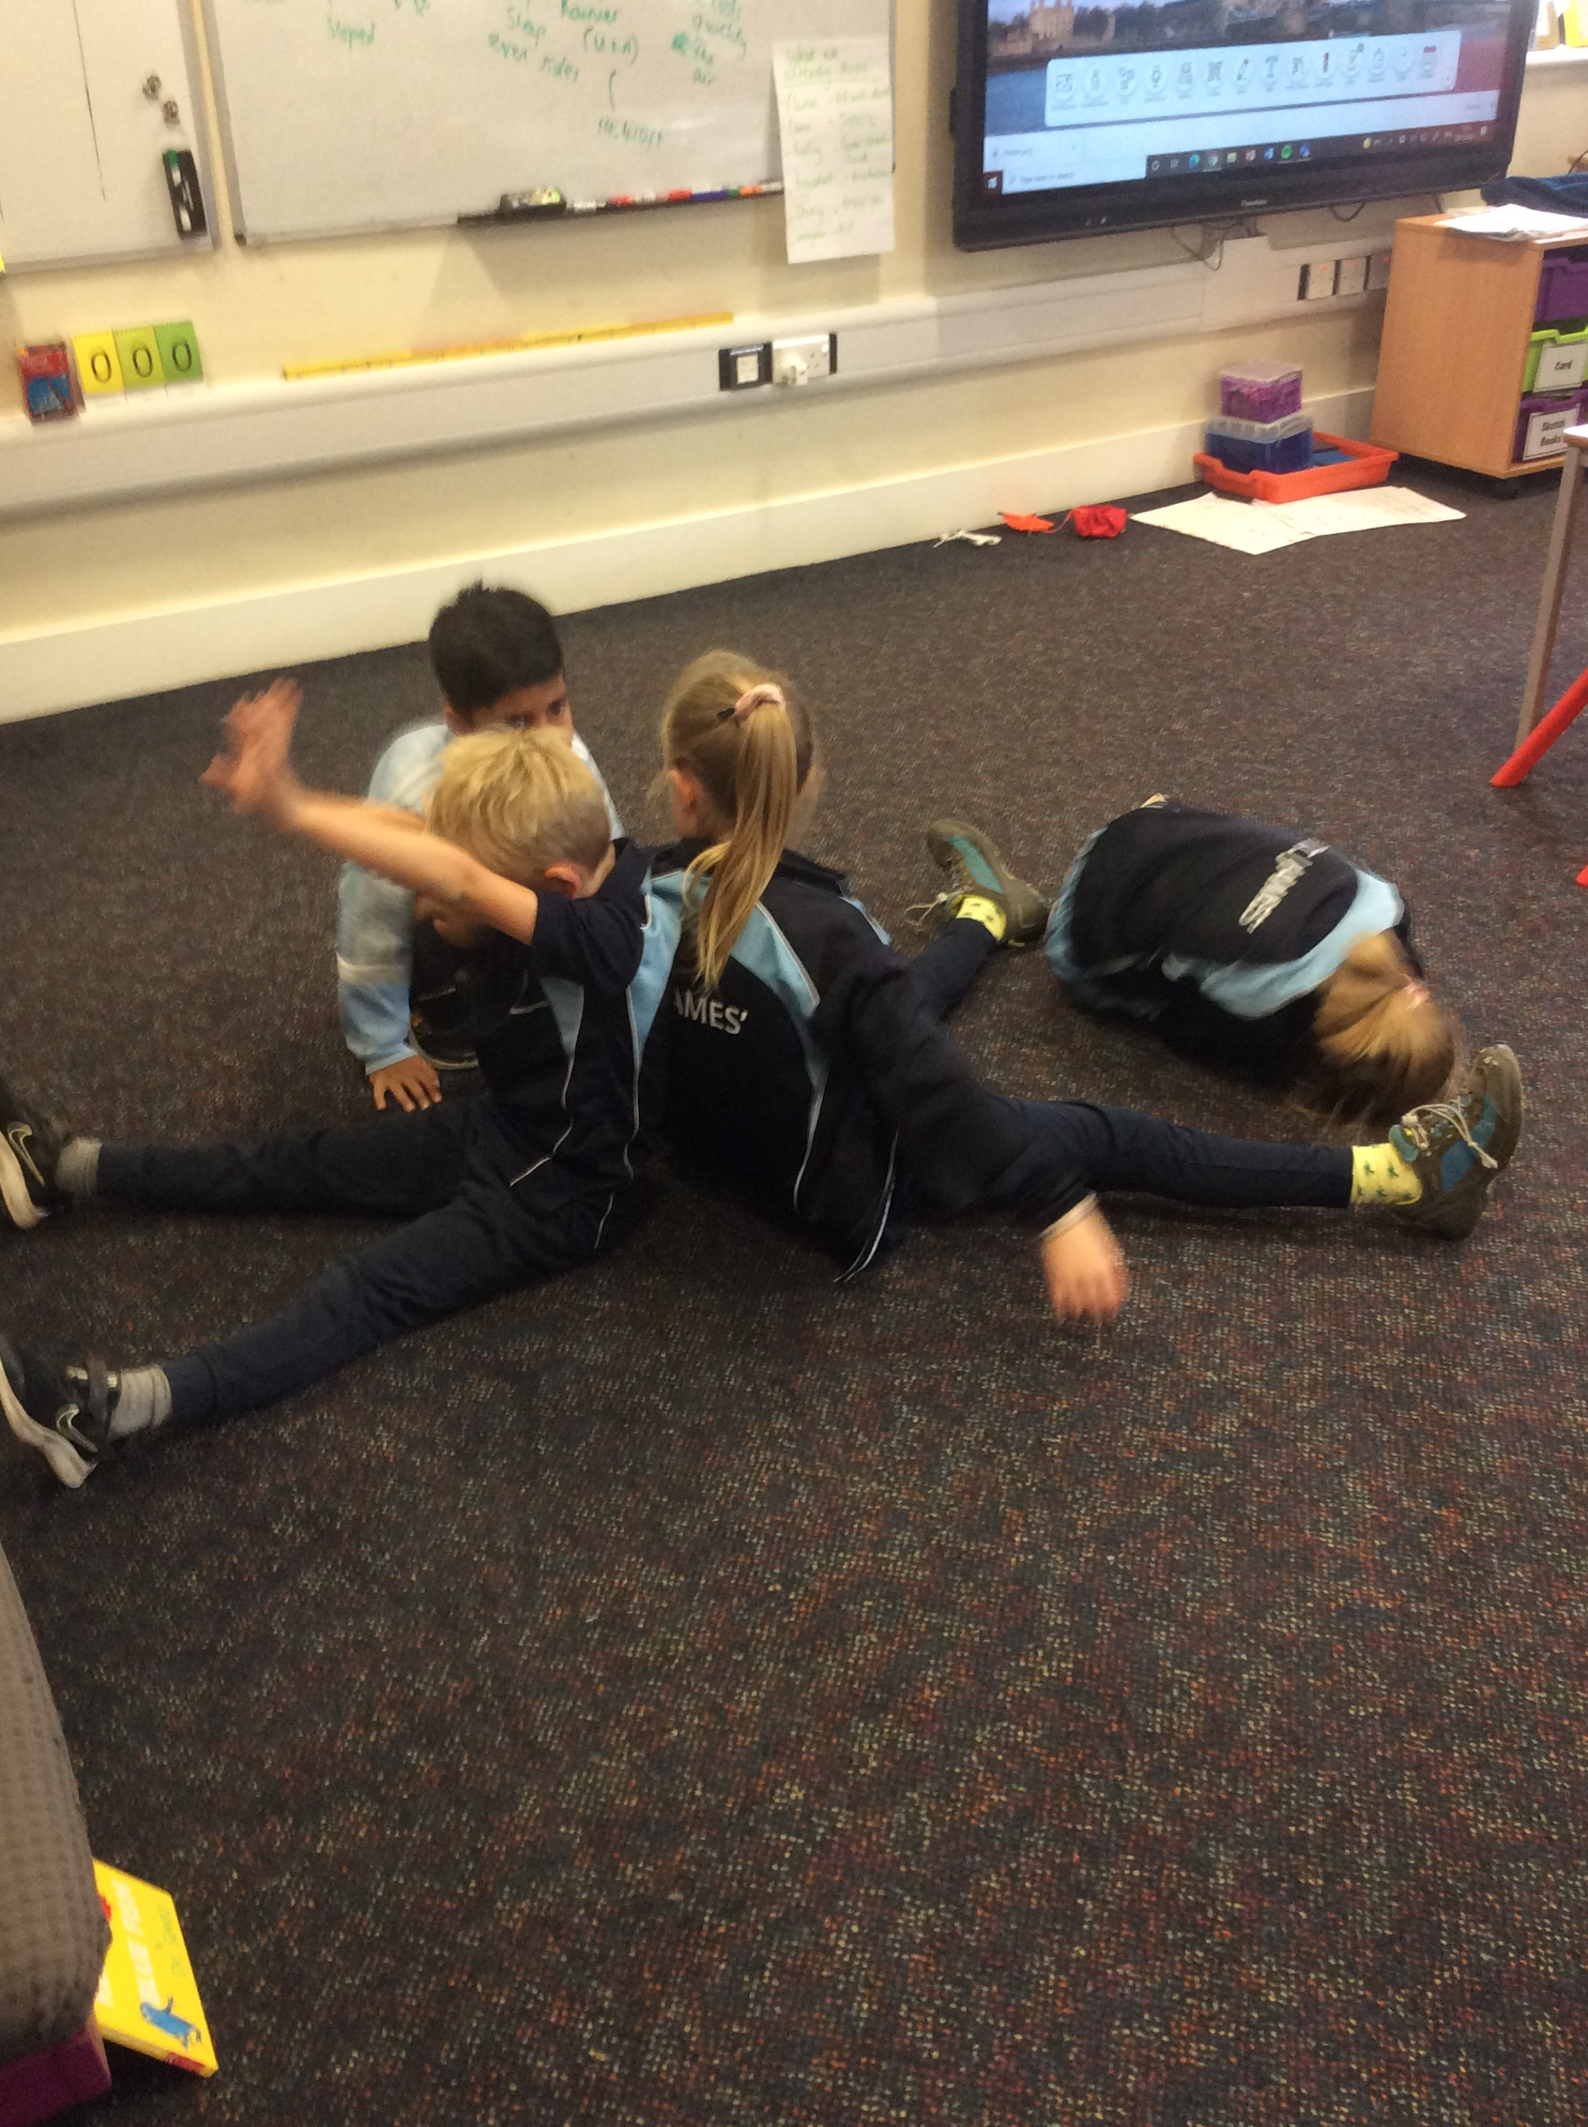
In action

Slide 11
Kagan at St. James’
So… what is Kagan?
Developed by Dr Spencer Kagan
Research based
Collaborative learning structures
Enhances learning for all children, regardless of ability, age, confidence

Slide 12
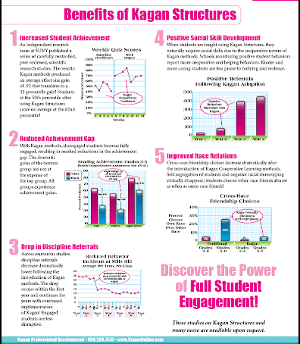
Why collaborate?
Research in to collaborative learning structures have shown us…
Increase in achievement and a narrowing of gaps
Increased engagement = less disruption in lessons
Improved self esteem for learners
Children knowing and remembering more – information sticking!

Slide 13
Tables and seating
Notes:
Our classrooms used to be like this…
Differentiated groups
T/TA sits with the LAP usually … they sit at the front, etc
Moved to a model where we don’t have the differentiated groups – our children support each other

Slide 14


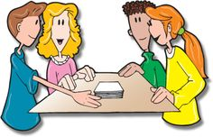




Supporting one another
Jot Thoughts
Numbered Heads
Quiz, Quiz, Trade
Notes:
Maths activity – partner A and B coaching each other
Writing activity?
When have I used this? Age group?

Slide 15
Facilitation or instruction?
Felt our lessons were too instructional - wanting to move away from the 'traditional' teaching style
​Wanted to develop the opportunities for the teachers become facilitators
Built mini teams in the classroom which improved morale and created friendships
Allowing opportunities for the children to be more active in lessons
Children using information rather than being given information
Allows teachers to ‘work the room’ – support where needed and not always in the same place!
Notes:
Ellyn example
Children’s perceptions of each other

Slide 16
Children being Active & Engaged
QQT – activity
Stand up, hand up, pair up
Inside, outside circle/traverse - activity
traverse
Inside, outside circle
Notes:
Blood flow
Oxygen to the brain
Movement break but still learning
More fun as I get to see my friend!
Teacher can structure SHP – numbered ability – differentiate tasks
Feed in to Rally Robin

Slide 17
Collaborative (Kagan) structures
 | Size | Thinking Skills | Class Building | Knowledge Building | Process Info | Procedure Learning
Rally Robin | P
All write Round Robin | T
Rally Coach | P
QQT/SHP | C
Jot Thoughts | T
Numbered Heads | C

Slide 18
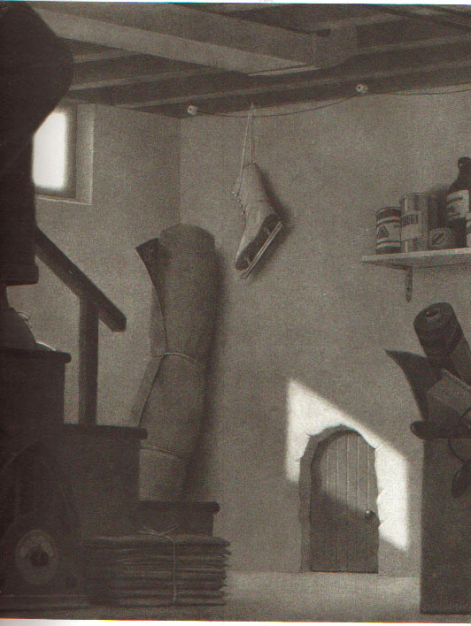
All write round robin
Create a list on your own of as many adjectives as you can to describe this image
Notes:
Create a list on own and then all write?
Talk about reluctant writers
Those that whizz ahead

Slide 19
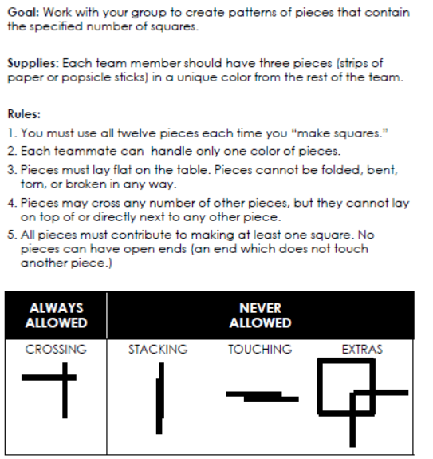
Co-operative project

Slide 20

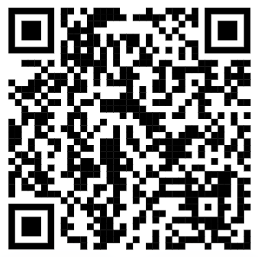
Questions?

Slide 21
Collaborative learning
Teaching & learning at St. James’
Mr Bradley,
Curriculum Lead
Teaching & learning lead

